Slide 1
Time plan and deadlines
Week 44-45 - Introduction lectures
- Start lab: Intro to Simulink. (About 20 hours of work)
- Electronic quizzes in webct - Choose a standard and en existing model to simulate
Week 46 - Assignment 1 (homework problem). - Conclude lab (demonstrate to teachers)
Week 47-48 - Present chapter 2 for class: Theory study – present a
standard and review a research paper
- Present chapter 3 for class: Model – present an existing simulation model
Week 49-50 - Discuss chapter 1 with teachers: Introduction (goal of your project) - Demonstrate chapter 4: Modifications to an existing simulation model, or a new model that you have built.
Week 51-02 - Demonstrate some simulation results to teachers.
Week 02-03 - Final report and project presentations, incl chapter 5: Results, and chapter 6: Conclusions.

Slide 2
Suggestions for projects
Suggestions for Simulink models or Matlab toolboxes
ADSL | 2
Bluetooth voice transmission | 2
DVB-T (orig. web based sim) | 2
IEEE 802.11b PHY | 2
IEEE 802.11a | 2
IEEE 802.16 (SISO) | 2
WCDMA end-to-end PHY | 2-3
CDMA2000 | 2-3
IEEE 802.16 MISO | 2-3
New Ethernet PHY model 10/100/1000 Mbps | 3
ZigBee (Ole Wendland model) | 3
GSM call setup / queeing theory | 3
The Prowler toolbox for WSN | 3
The RUNE toolbox for trad cellular networks | 3
Digital transmission over audio Develop own model | 3 2-4

Slide 3
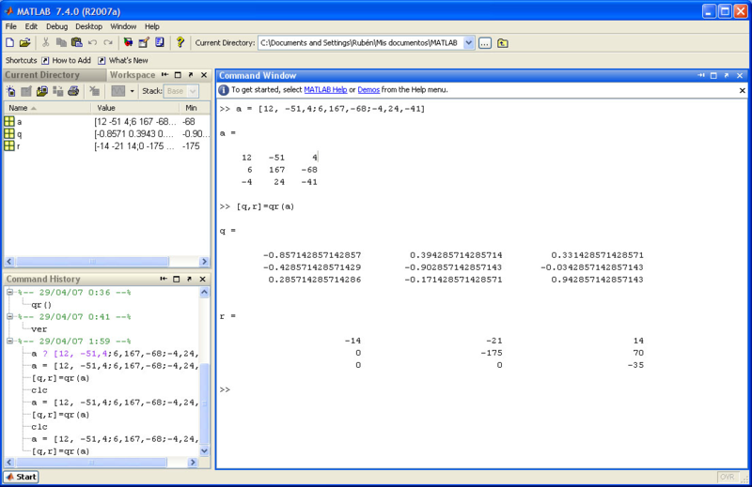
This is how MATLAB looks like
Workspace:
Command history
Command window:

Slide 4
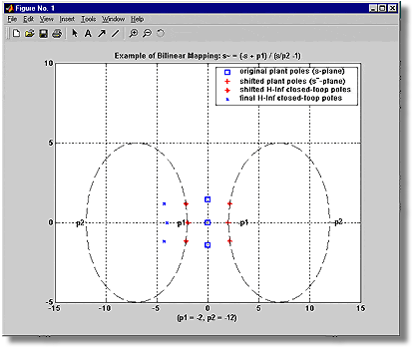
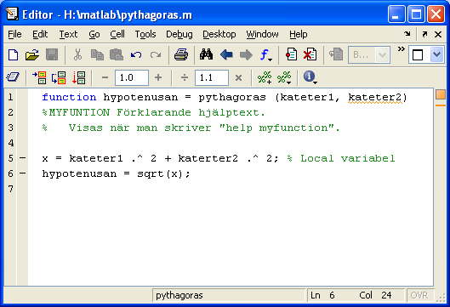
More MATLAB windows
Figure window
Array editor
M-file editor

Slide 5
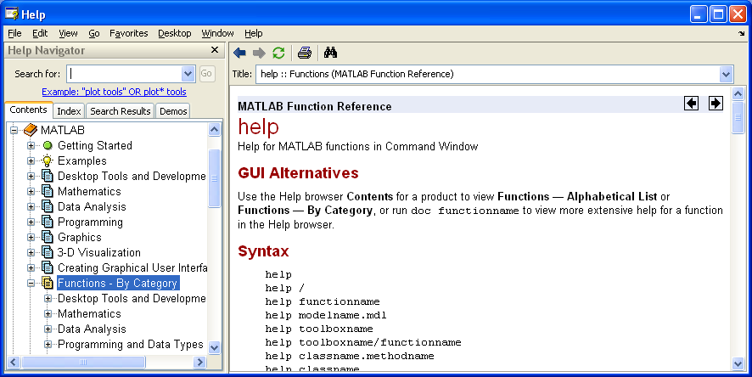
How to get help in MATLAB?
help functionsname
Shows unformatted text
doc funktionsnamn
Shows HTML documentation
in a browser

Slide 6
MATLAB
Matlab and Simulink
MATLAB – Matrix Laboratory.
Simulink – A graphically programmed data-flow oriented tool within Matlab for modeling and analysis of dynamic systems.
Matlab function - .m-file that starts with the reserved word “function”. May also be an internal function or a compiled function. A Matlab function has its own workspace for local arrays (variables).
Matlab script – .m-file that does not include a function header. Affects arrays (variables) in the base workspace.
Toolbox – a set of Matlab-functions and scripts,
Blockset – a library of Simulink models.
Array – A variable in Matlab. An array may be
- a scalar (singel element),
- a row vector (1 by N elements),
- a column vector (N by 1 elements),
- a matrix (M by N elements, i.e. a 2D array),
- a multidimensional array (for example 3D array, concisting of K pages, where each page is an M by N matrix),
- a struct (consisting of named fields, where each field is an array. For example, the struct a may consist of the fields a.b and a.c.)
The elements in an array can be real valued or complex valued.
Base workspace – The arrays (variables) that are seen from the command line, or from a Matlab script, but not from a Matlab function.

Slide 7
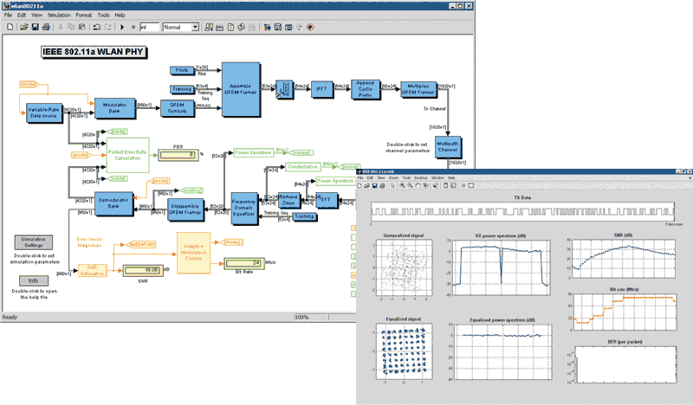
SIMULINK
SIMULINK: Toolbox in Matlab
that allows graphical data-flow oriented programming.

Slide 8
Simulink terminology
Multirate model = A Simulink model that contains signals with different sample times, for example different bit rates.
Sample time = Updating a signal integer multiples of a fixed time interval called the sample time
Samples per frame = How many samples each frame contains.
Sample time = Frame period / Samples per frame
A Frame is a block of values, representing for example a sequence or samples, combined into a vector. Frame-based simulation may result in faster simulation time than sample-based simulation.
In sample-based processing a system of blocks is simulated for one sample at a time.
In frame-based processing, all of the samples in a frame are processed before next block is simulated.
A triggered sub-system may sample a signal at asynchronous instants or events rather than at a fixed sample rate.

